Slide 1
Standard Deviation
Year 11 Essentials

Slide 2
24
7
30
Standard deviation
Date
EQ – what is standard deviation and how do we calculate it?
The standard deviation is a number that measures how far away each number in a set of data is from their mean.
The mean is represented by the symbol “ x̅ ”
To find the mean, we add all scores together, and divide the result by the number of scores.

Slide 3
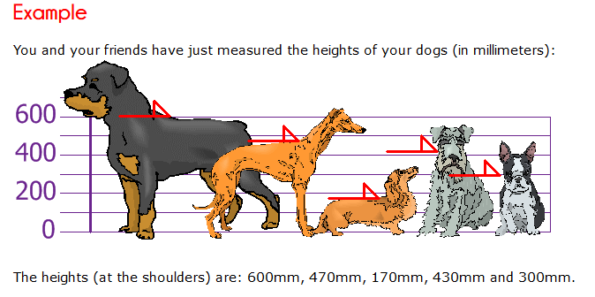

Step 1: Calculate the Mean

Slide 4
Step 2: Calculate the distance
Value - Mean | 600 – 394 = 206 | 470 – 394 = 76 | 170 – 394 = -224 | 430 – 394 = 36 | 300 – 394 = -94

Slide 5
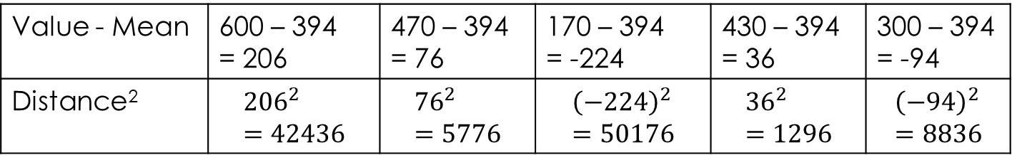
Step 3: Square the distance
Value - Mean | 600 – 394 = 206 | 470 – 394 = 76 | 170 – 394 = -224 | 430 – 394 = 36 | 300 – 394 = -94
Distance² | $${206}^{2}=42436$$ | $${76}^{2}=5776$$ | $${\left(−224\right)}^{2}=50176$$ | $${36}^{2}=1296$$ | $${\left(−94\right)}^{2}=8836$$

Slide 6



Step 4: Calculate the mean of the square distances
Value - Mean | 600 – 394 = 206 | 470 – 394 = 76 | 170 – 394 = -224 | 430 – 394 = 36 | 300 – 394 = -94
Distance² | $${206}^{2}=42436$$ | $${76}^{2}=5776$$ | $${\left(−224\right)}^{2}=50176$$ | $${36}^{2}=1296$$ | $${\left(−94\right)}^{2}=8836$$
$$Variance=\frac{42436+5776+50176+1296+8836}{5}$$
$$Variance=\frac{108 520}{5}$$
$$Variance=21704$$

Slide 7

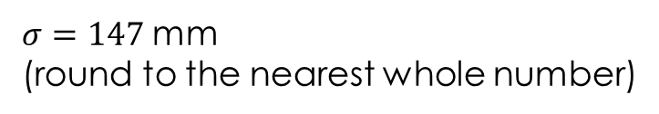


Step 5: Find the Square Root of the VAriance
Value - Mean | 600 – 394 = 206 | 470 – 394 = 76 | 170 – 394 = -224 | 430 – 394 = 36 | 300 – 394 = -94
Distance² | $${206}^{2}=42436$$ | $${76}^{2}=5776$$ | $${\left(−224\right)}^{2}=50176$$ | $${36}^{2}=1296$$ | $${\left(−94\right)}^{2}=8836$$
$$Variance=21704$$
$$σ=\sqrt{21704}$$
$$σ=147.32$$
$σ=147$mm
(round to the nearest whole number)

Slide 8
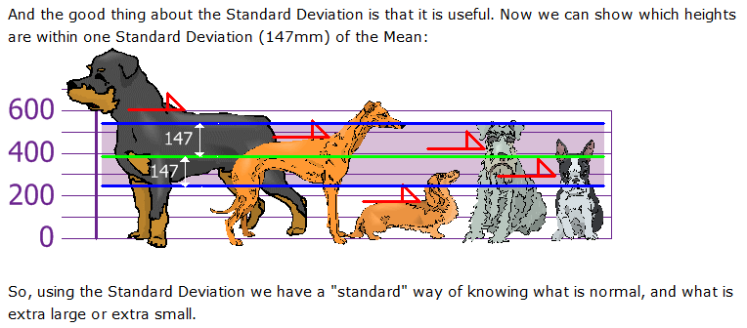
Step 5: What does the Standard Deviation Show?

Slide 9
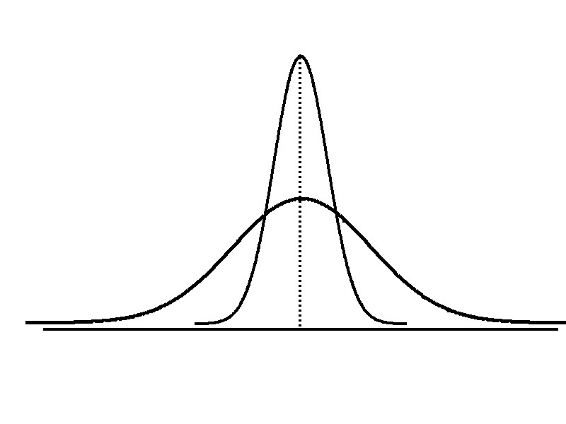
Measures of Dispersion: Comparing Standard Deviations
Smaller standard deviation
Larger standard deviation

Slide 10
Measures of Dispersion: Comparing Standard Deviations
If the Standard Deviation is large, it means the numbers are spread out from their mean. If the Standard Deviation is small, it means the numbers are close to their mean.
large,
small,

Slide 11
The price of 6 cars is listed below ($1000’s)
5 , 6 , 7 , 8 , 10 , 11
Find the Mean and Standard deviation of the scores
– Use the single digits, not the full number use 4 instead of 4000.

Slide 12

MEAN:
5+6+7+8+10+11
= 47 $÷$ 6
= 7.8
Standard deviation:
(5-7.8)² + (6-7.8)² + (7-7.8)² + (8-7.8)² + (10-7.8)² + (11-7.8)²
26.84 $÷$ 6 = 4.473
$$\sqrt{4.473}$$
$=2.11$ or 2

Slide 13
Page 134 & 135
Question 3 , 4 , 5

